Slide 1

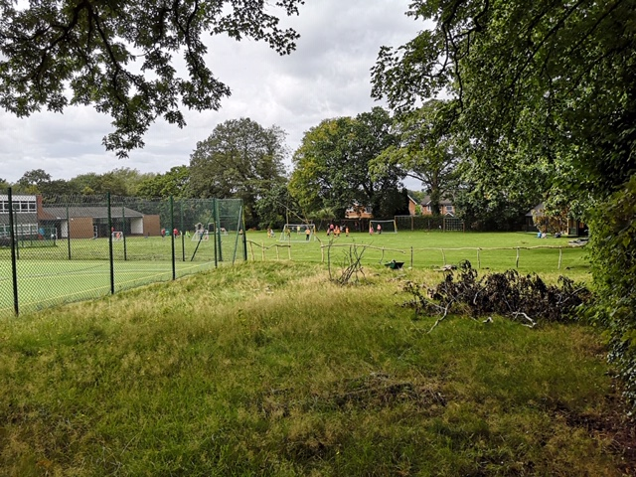
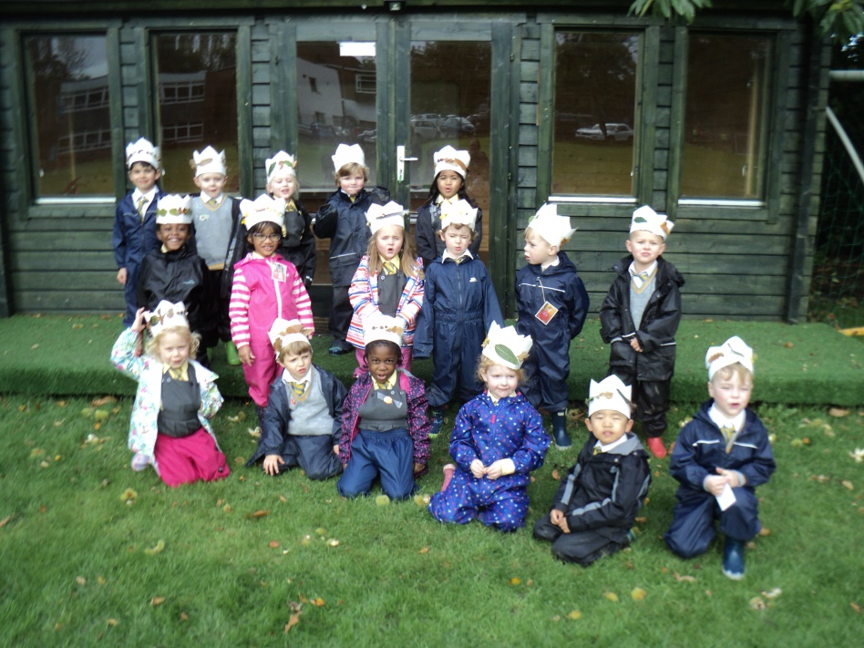
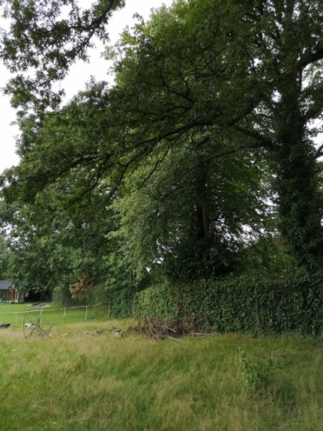
Forest School at Greenbank
GREENBANK PREPARATORY SCHOOL
AND DAY NURSERY

Slide 2
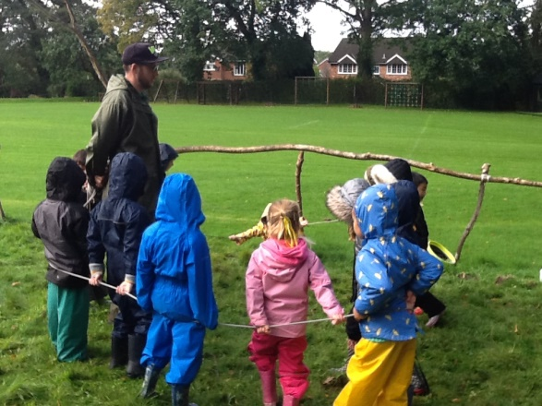
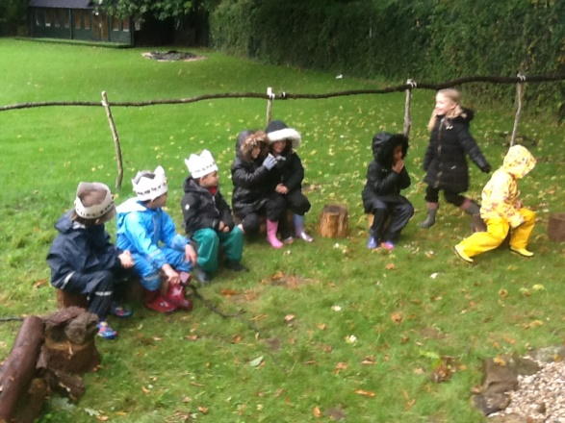
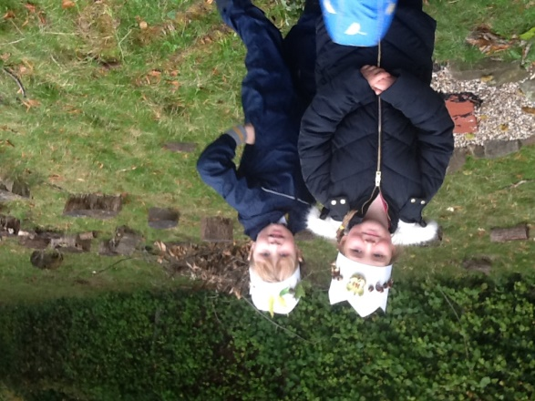
What we do at Forest School?
Build dens and shelters
Play games and take part in physical activities
Be creative
Hunt for minibeasts
Identify a range of living things
Use tools safely
Play in the mud
Work as a team and support each other
Look after the environment
Help to make fires and cook outside
GREENBANK PREPARATORY SCHOOL
AND DAY NURSERY

Slide 3
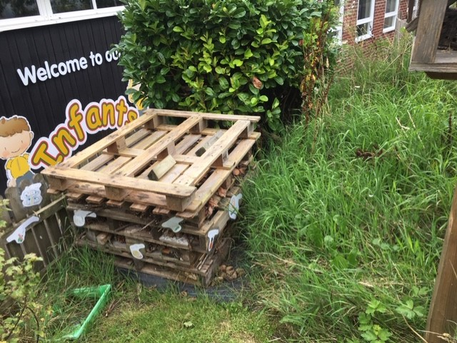
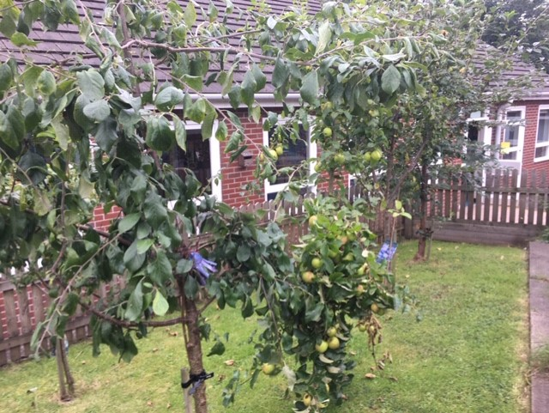
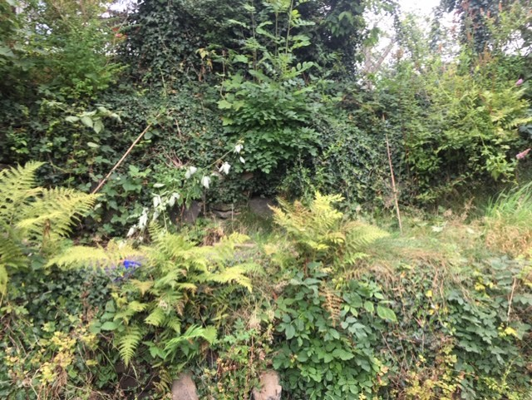
Where will it take place?
GREENBANK PREPARATORY SCHOOL
AND DAY NURSERY
Forest School log circle area
Around the whole school grounds
Eco garden
School field
Outdoor classroom
Looking into future opportunities to use the park next to school

Slide 4
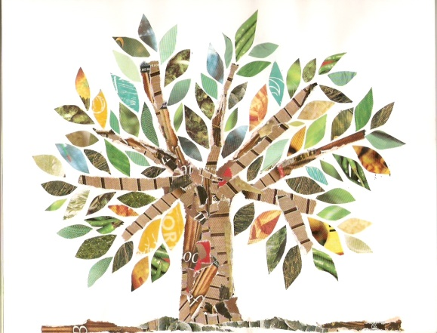
What happens during a Forest
School Session?
GREENBANK PREPARATORY SCHOOL
AND DAY NURSERY
Introduction game and check in – revisit rules/boundaries for safety and behaviour
Main session – one small achievable task which the children can choose to do if they want to building on their interests from previous session
Skills taught using tools in small groups – peelers for carrots and sticks for example
Free exploration of environment
Fire circle safety game and circle time reflection in log circle

Slide 5
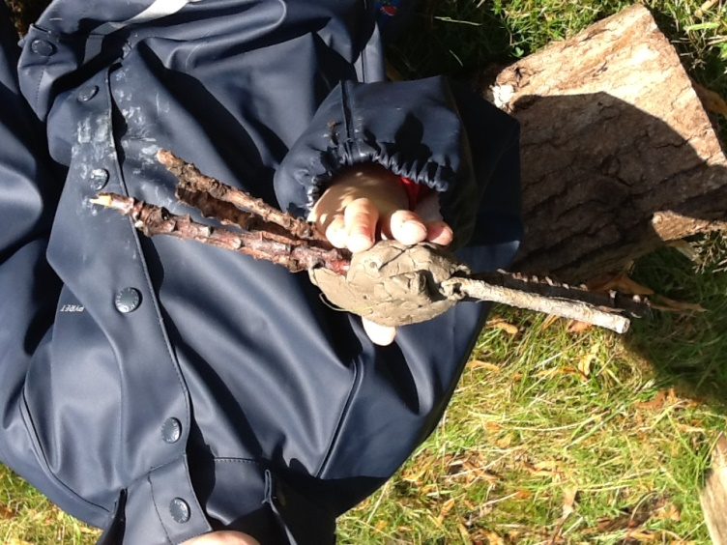
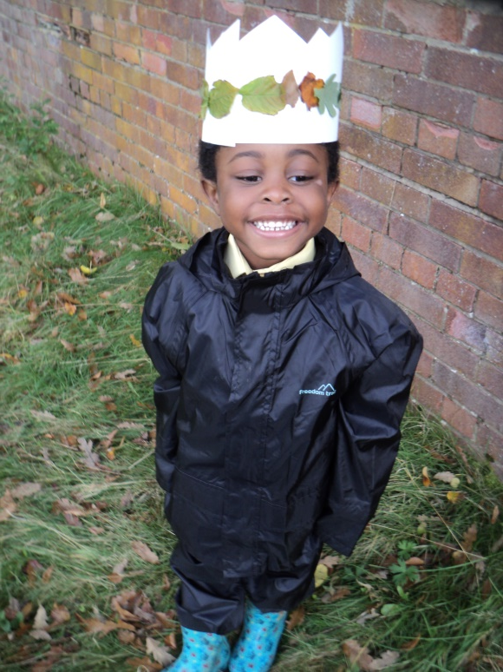
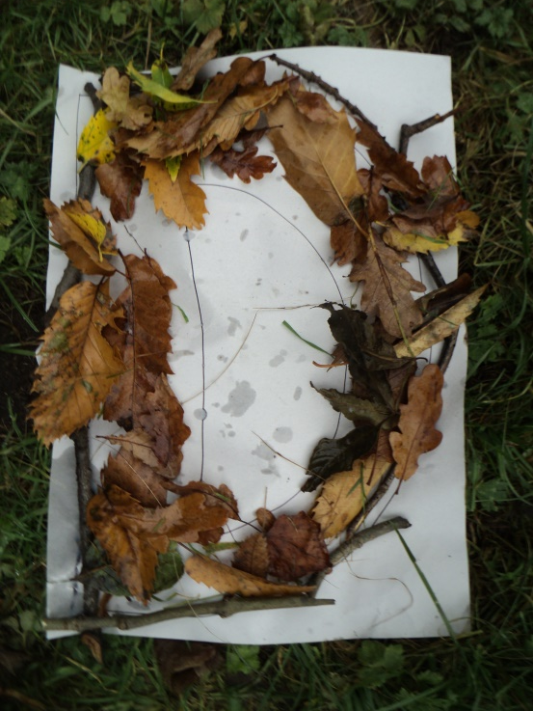
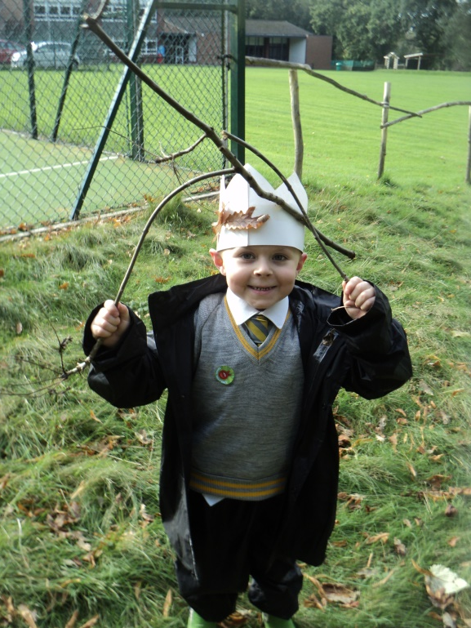
GREENBANK PREPARATORY SCHOOL
AND DAY NURSERY
Creative

Slide 6


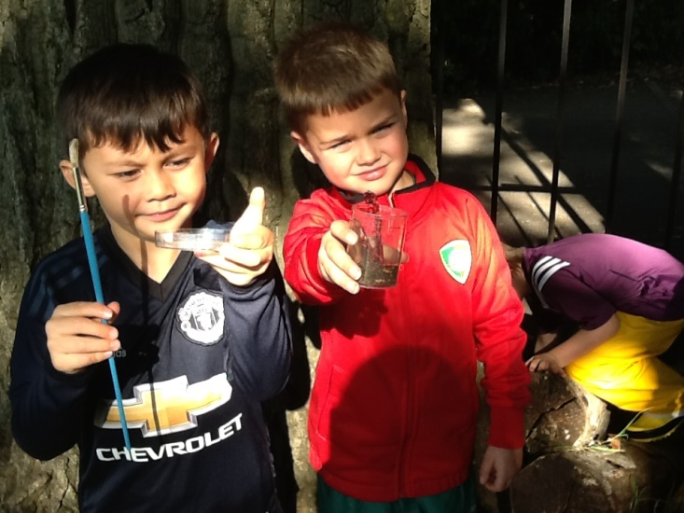
GREENBANK PREPARATORY SCHOOL
AND DAY NURSERY
Teamwork

Slide 7
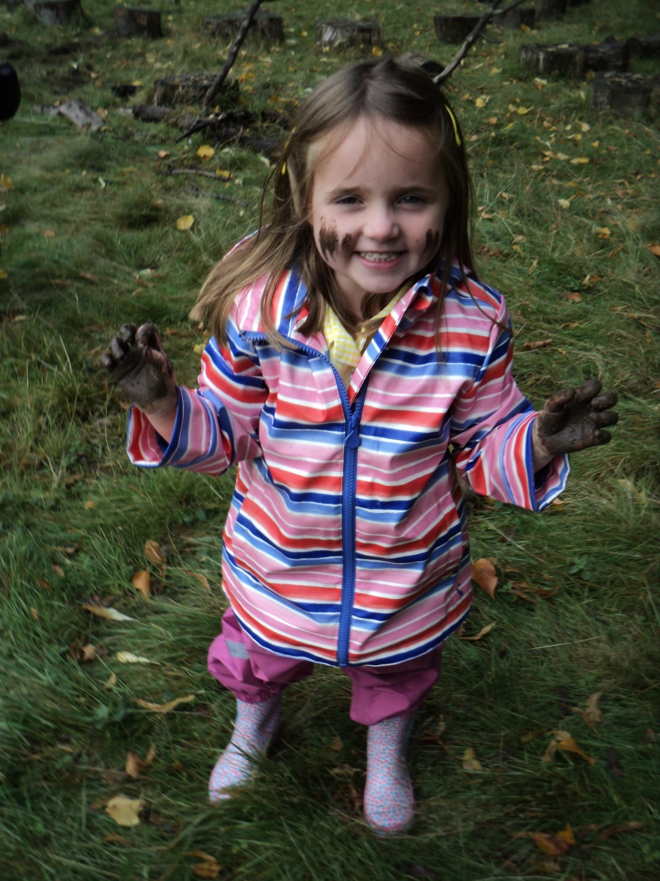
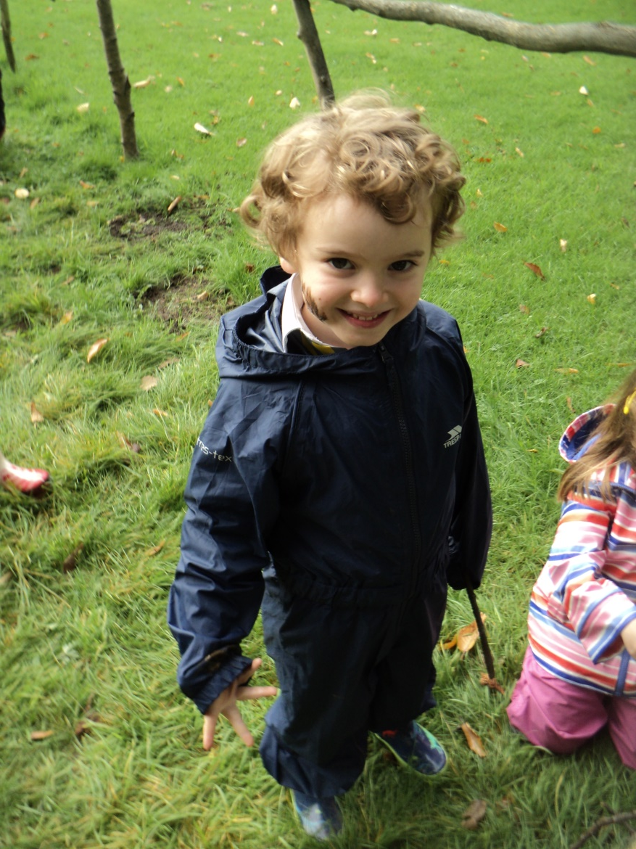
GREENBANK PREPARATORY SCHOOL
AND DAY NURSERY
Mud

Slide 8
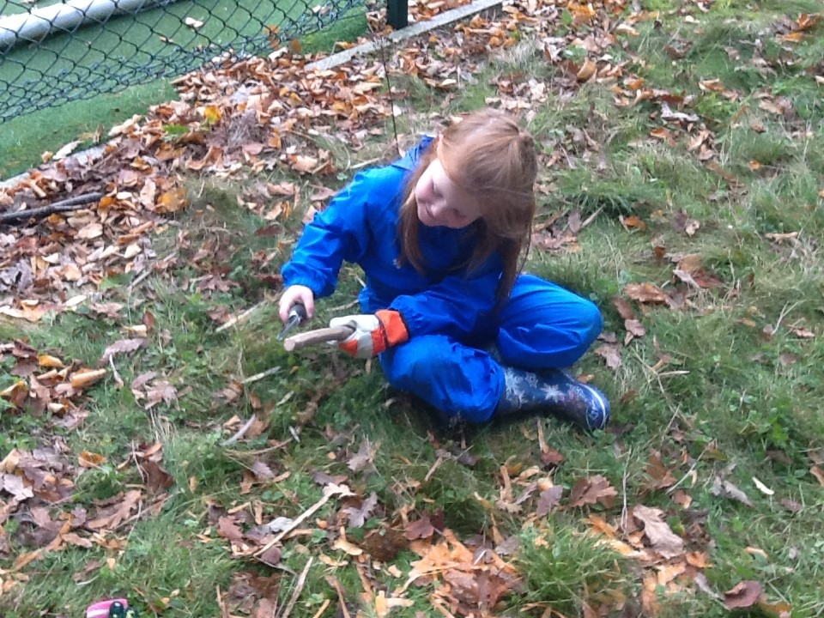
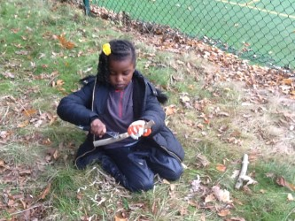
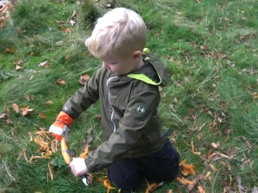
GREENBANK PREPARATORY SCHOOL
AND DAY NURSERY
Using tools

Slide 9
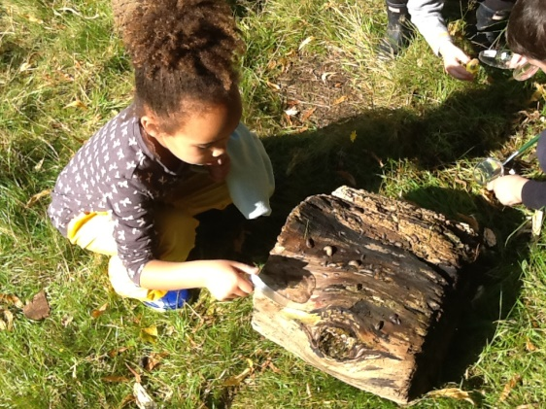
What is Forest School?
Forest School is an inspirational process, that offers all learners regular opportunities to achieve and develop confidence and self esteem, through hands on learning experiences in a woodland or natural environments with trees.
Forest School is process not product led, so it’s not so much about what you learn as about how you learn it.
GREENBANK PREPARATORY SCHOOL
AND DAY NURSERY

Slide 10
History of Forest School
GREENBANK PREPARATORY SCHOOL
AND DAY NURSERY
Forest School is relatively new in the UK though it has increasingly gained awareness and popularity over the last few years. The idea of Forest Schools originated in Scandinavia, an apt beginning in a country where an active outdoor life is embedded.
Forest School was introduced to the UK in 1993 by a group of nursery nurses from Bridgewater College, Somerset. They had visited a Danish Forest School and were so impressed with the ethos and approach that they were keen to develop their own programme. Forest School has been rapidly developing since.

Slide 11
Benefits/Impact of Forest School
Forest School has positive effects on children’s learning, personal development, behaviour and self confidence.
Benefits:
Confidence
Social skills
Communication
Motivation and concentration
Physical skills
Knowledge and Understanding
New perspectives
Ripple effects
GREENBANK PREPARATORY SCHOOL
AND DAY NURSERY

Slide 12

Any questions?
GREENBANK PREPARATORY SCHOOL
AND DAY NURSERY
https://www.youtube.com/watch?v=o8limRtHZPs

